Slide 1
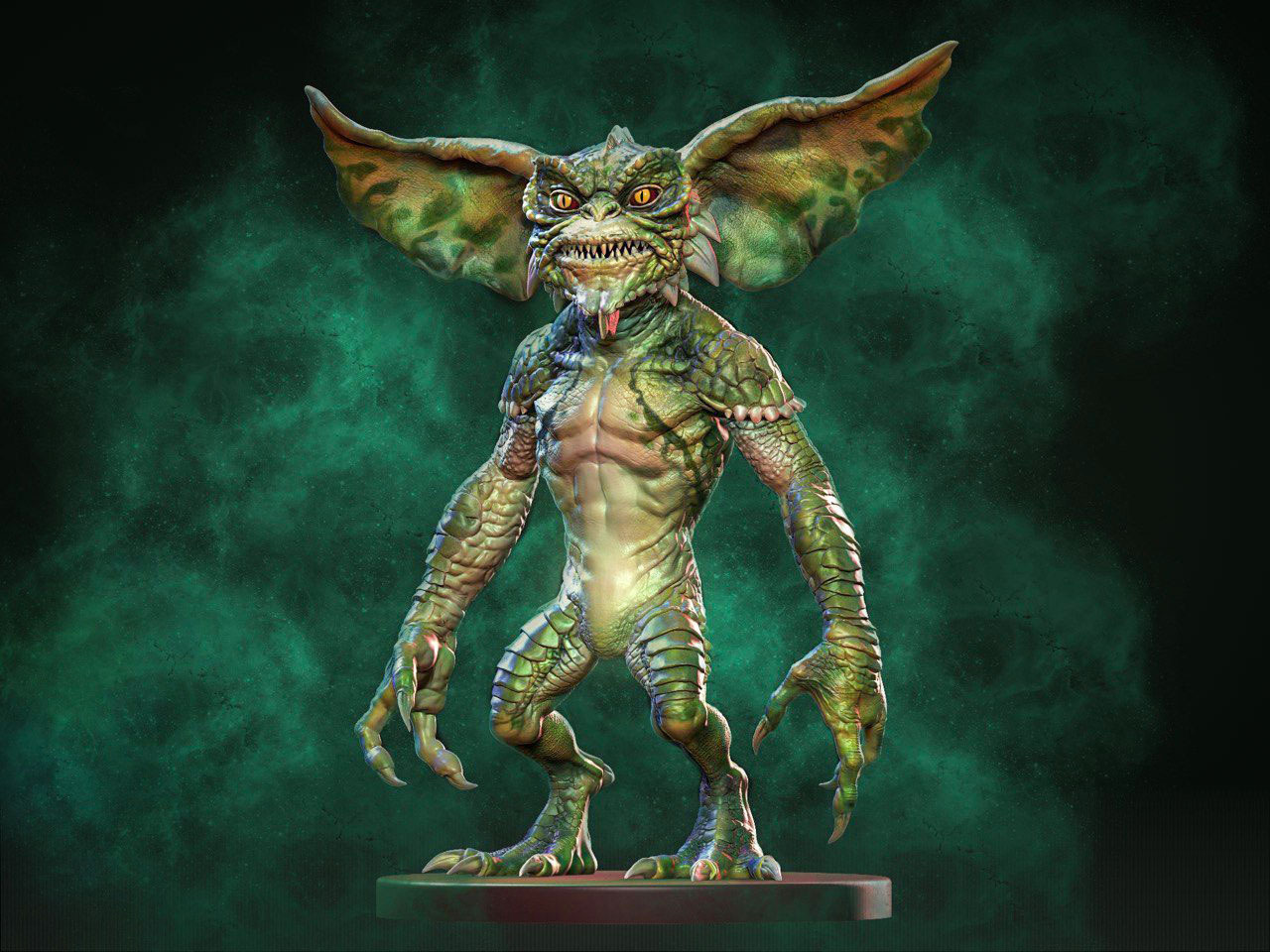
Gremlin Knight

Slide 2
Game Overview
https://www.loom.com/share/c6c50859b5b04c71afbf566c691b151a

Slide 3
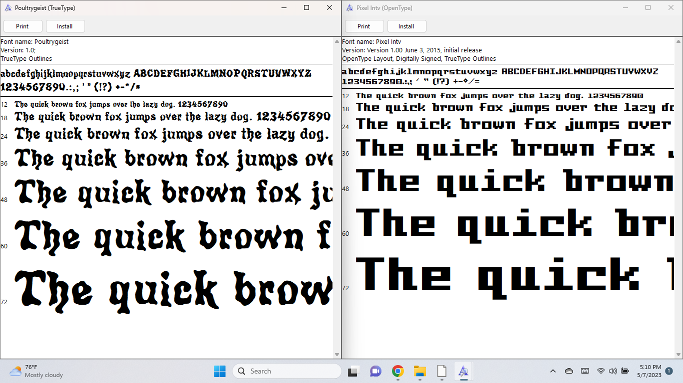
Game Assets and Resources: Fonts
From fontspace.com
Poultrygeist
Pixel

Slide 4
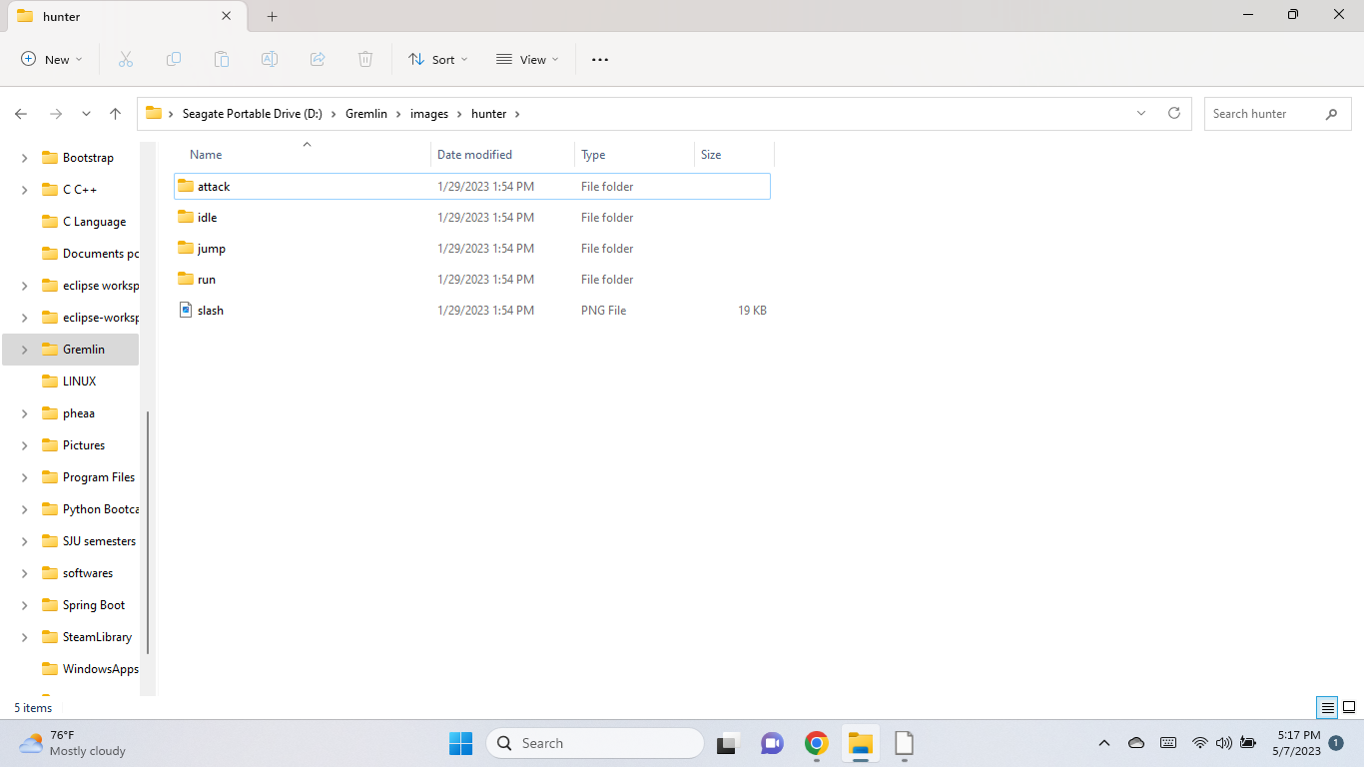
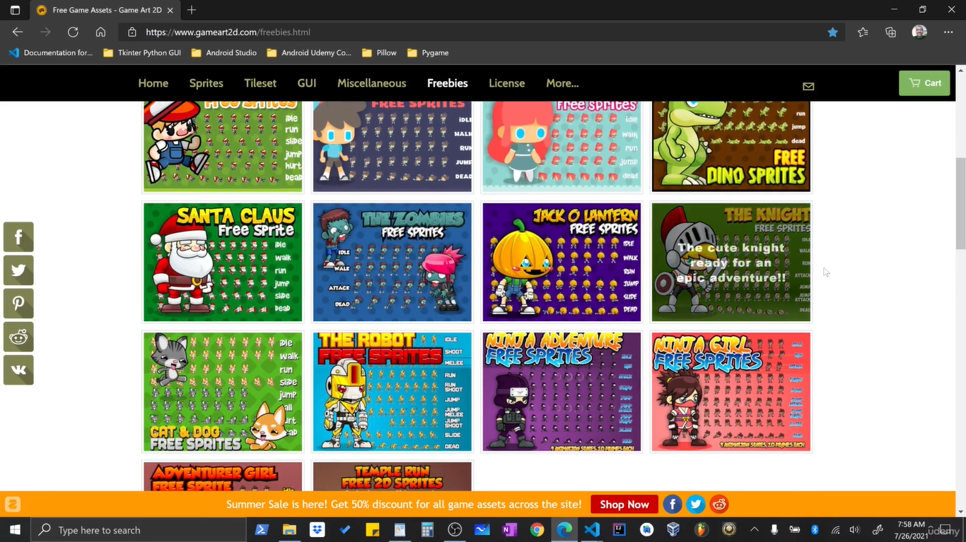
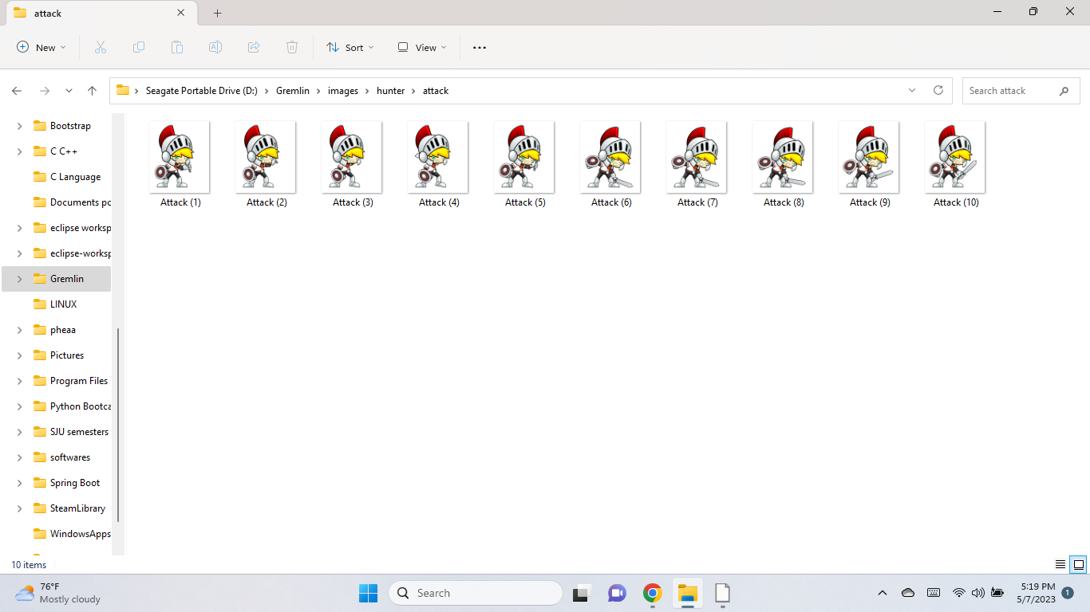
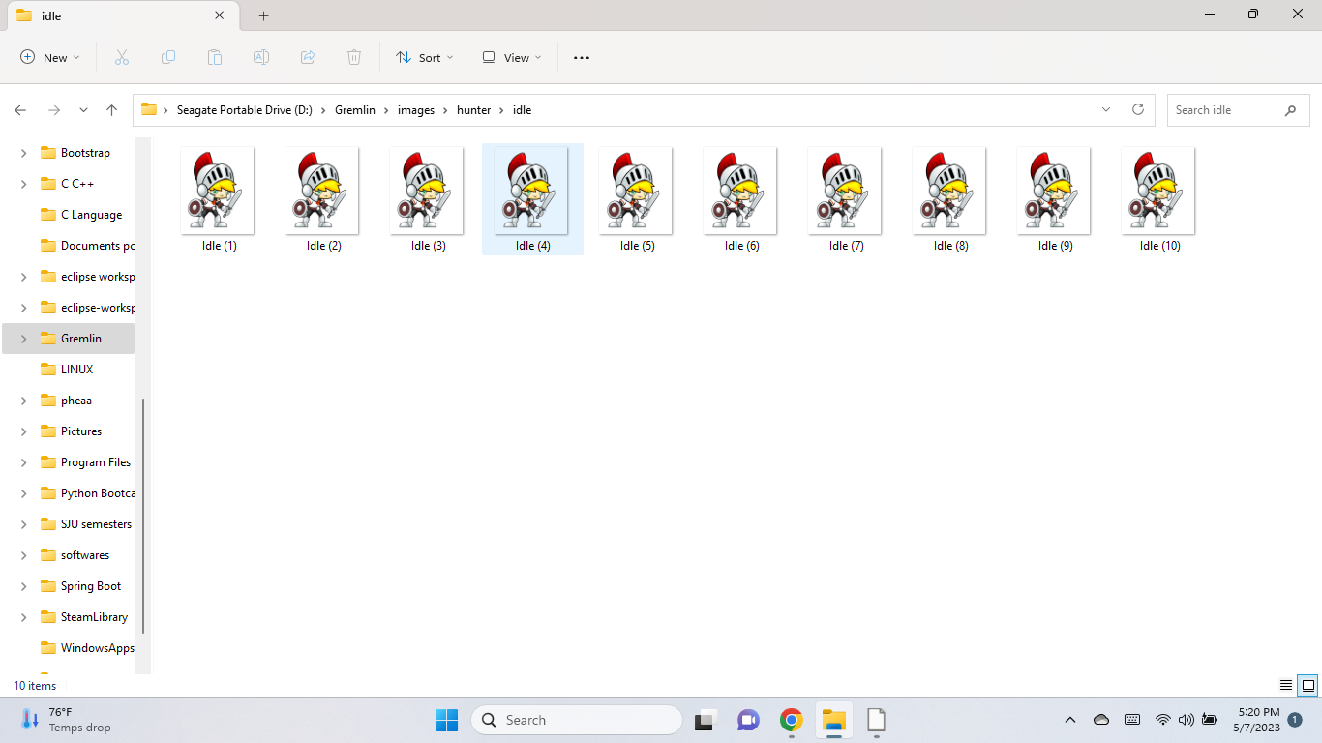
HUNTER
www.gameart2d.com

Slide 5
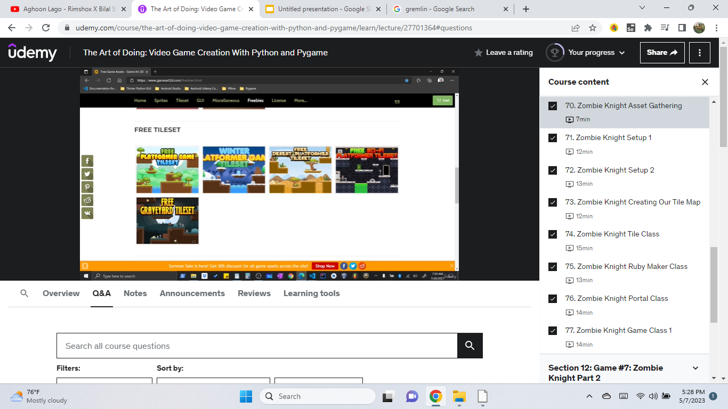
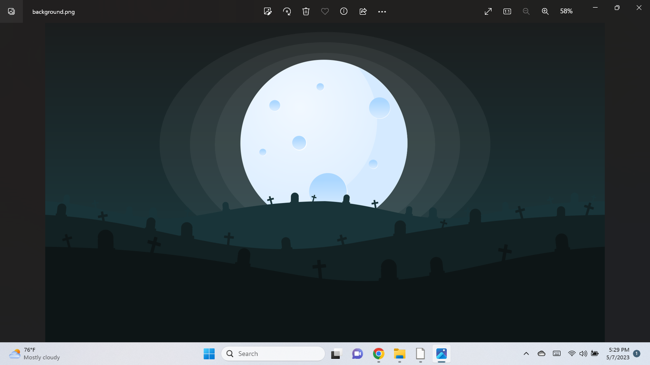
Background and Tile Maps
www.gameart2d.com

Slide 6
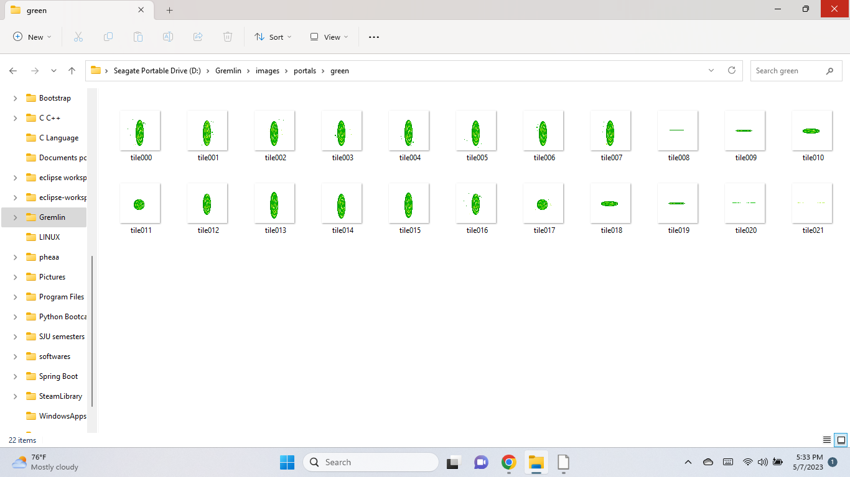
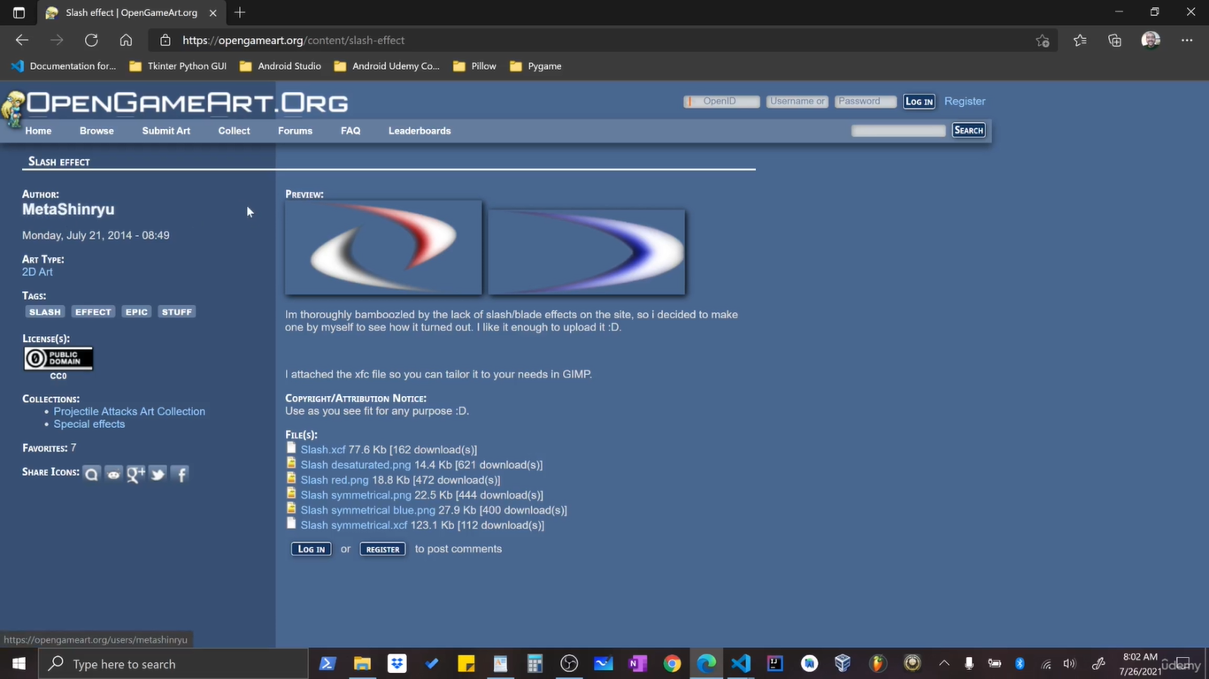
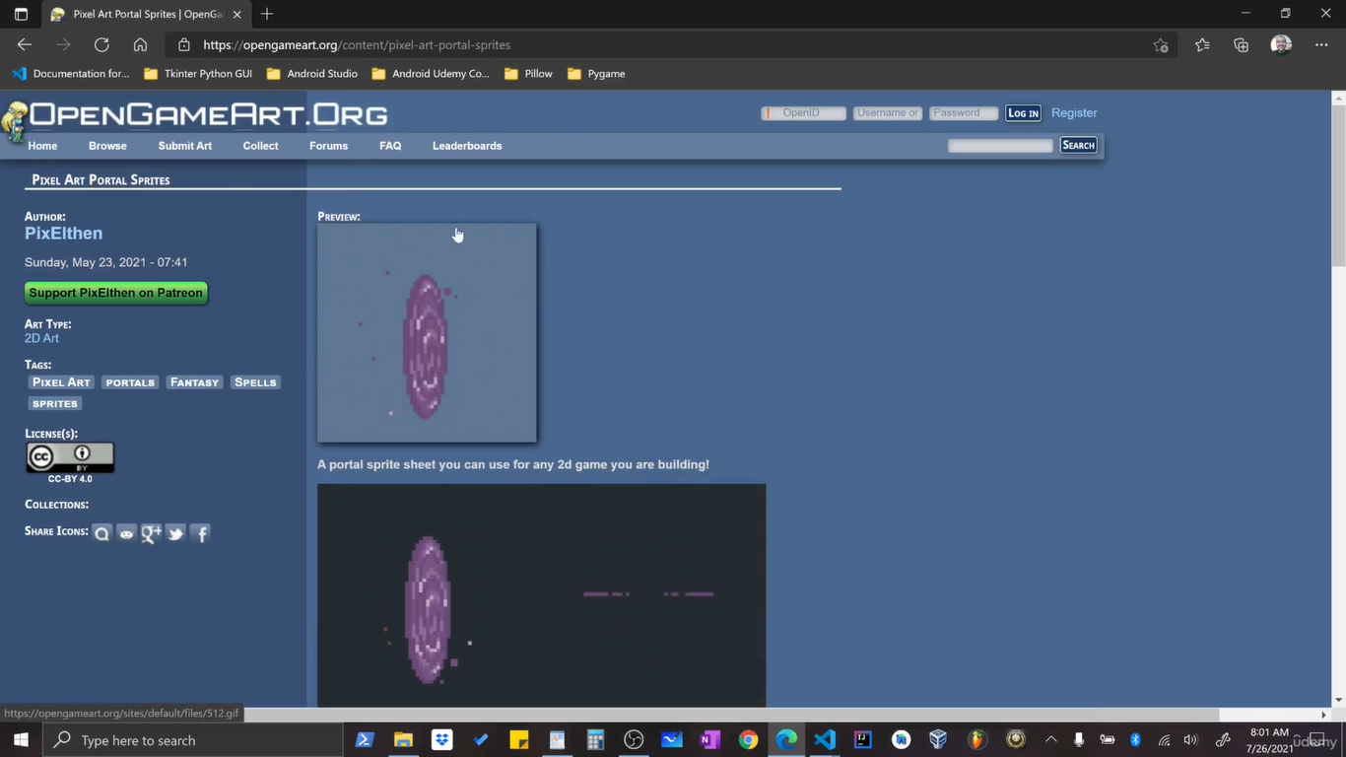
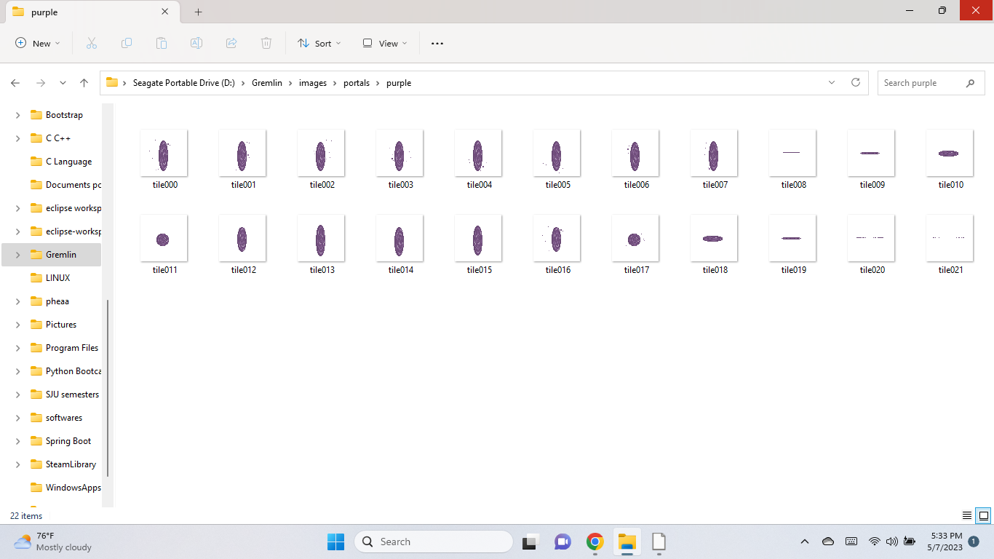
Portals and Sword Slash
www.opengameart.org

Slide 7
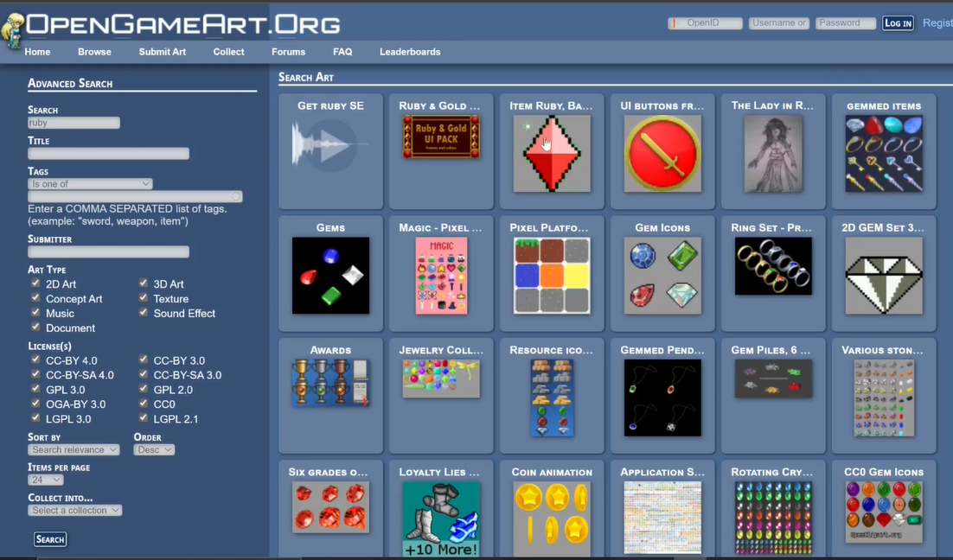
Diamond

Slide 8
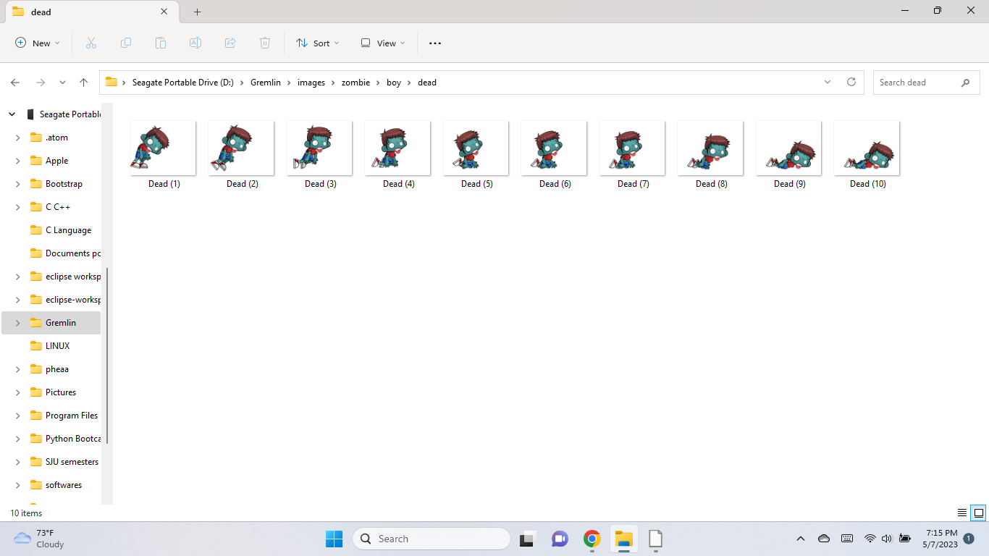
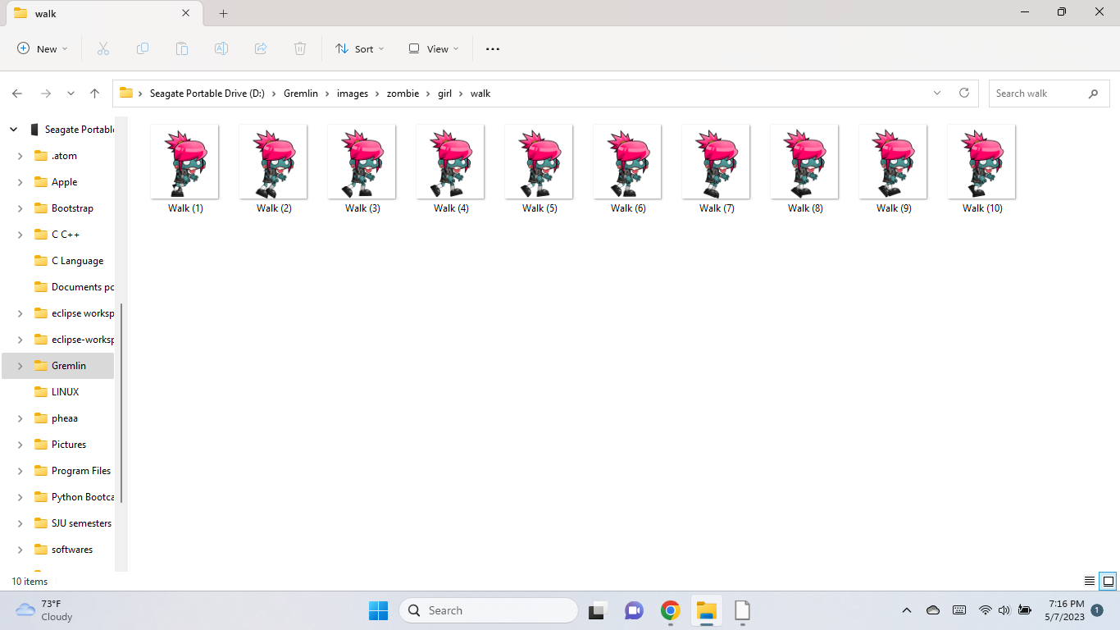
Gremlins (not exactly)
www.gameart2d.com

Slide 9
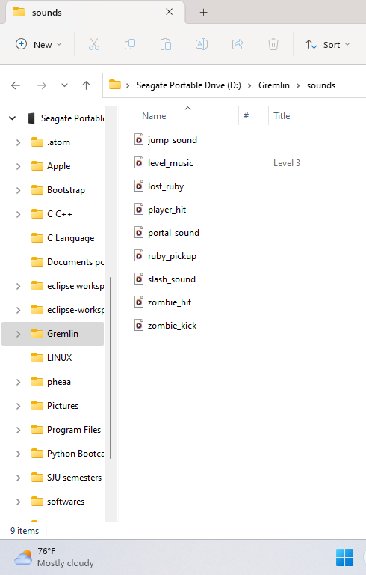
Sounds and Game Level music
Leshy Labs
Opengameart.org

Slide 10

Game Development Tools
Pygame Engine
Sprite class
Object Oriented Programming
2D - Tile Mapping
2D - Vectors

Slide 11
Game Development

Slide 12
Main.py
GameController class
Alien.py
Diamond.py
Diamond_Maker.py
Hunter.py
TileMapping.py
Game_portals.py
Bullet_Animate.py
Game Classes

Slide 13
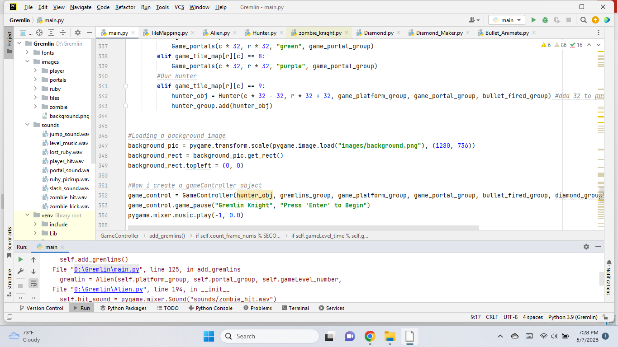
Background Image loaded

Slide 14
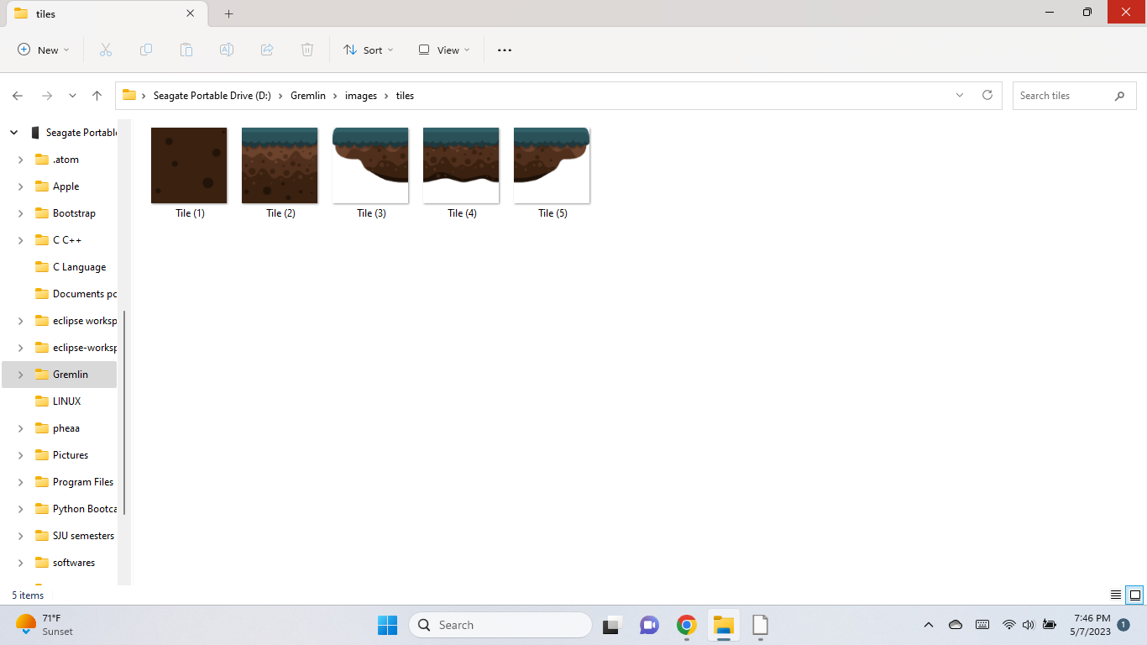
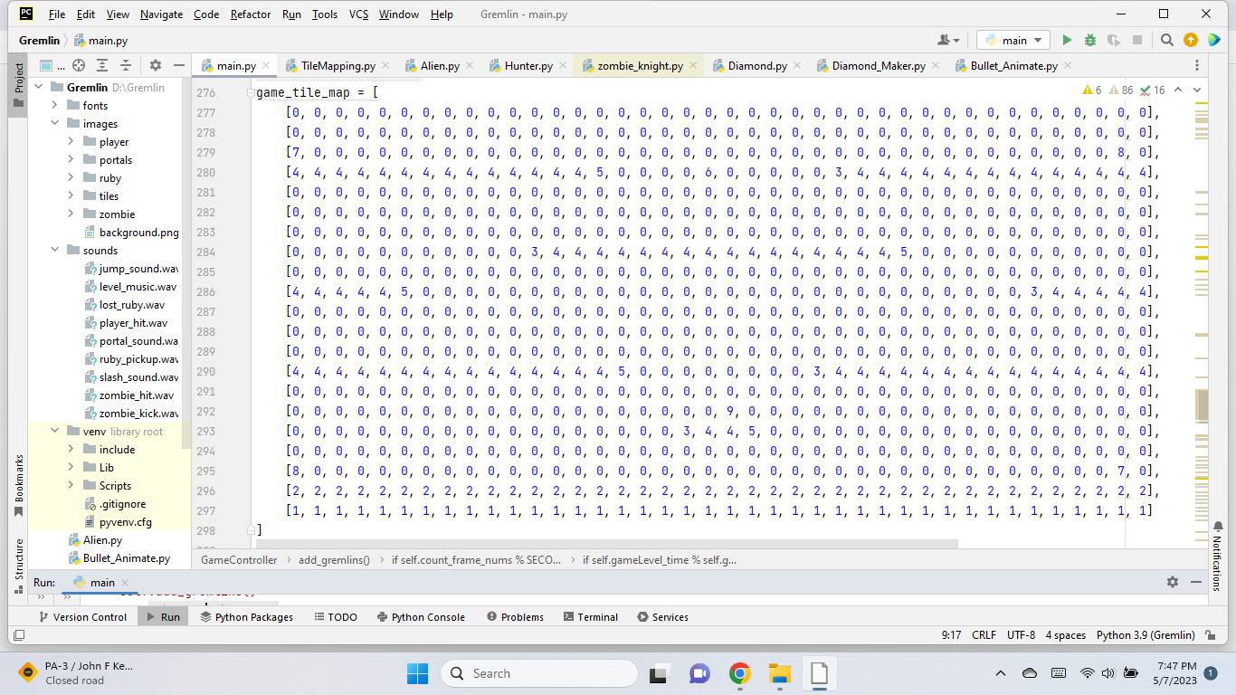
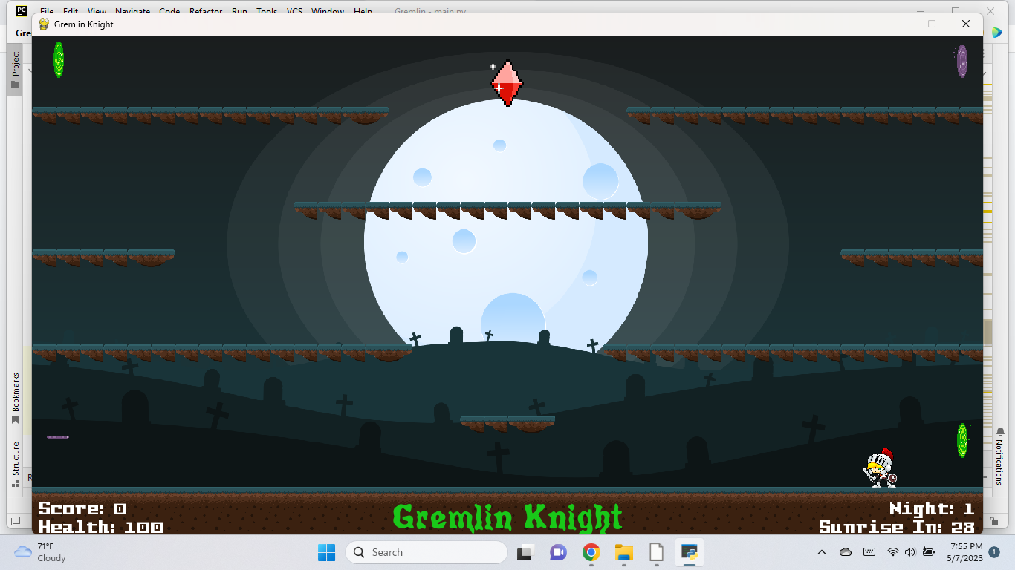
Tile Mapping

Slide 15
Animating and placing the Diamond

Slide 16
Animating and placing the Portals

Slide 17
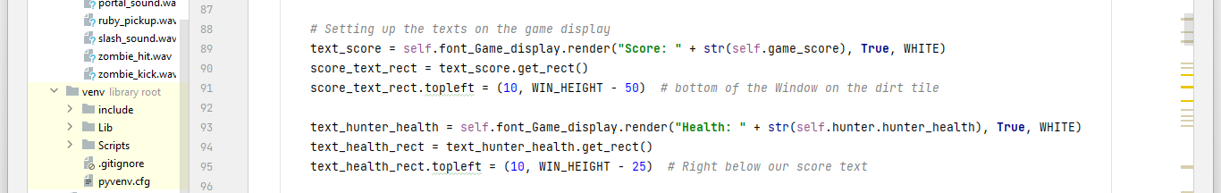
Setting up texts on the game display

Slide 18
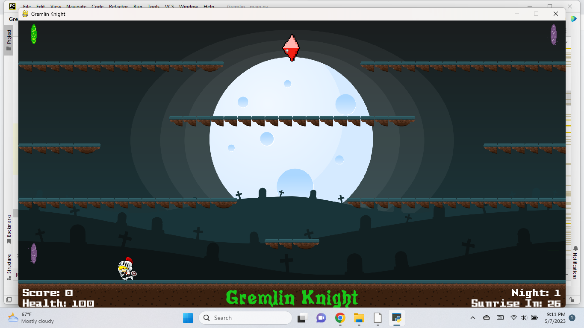
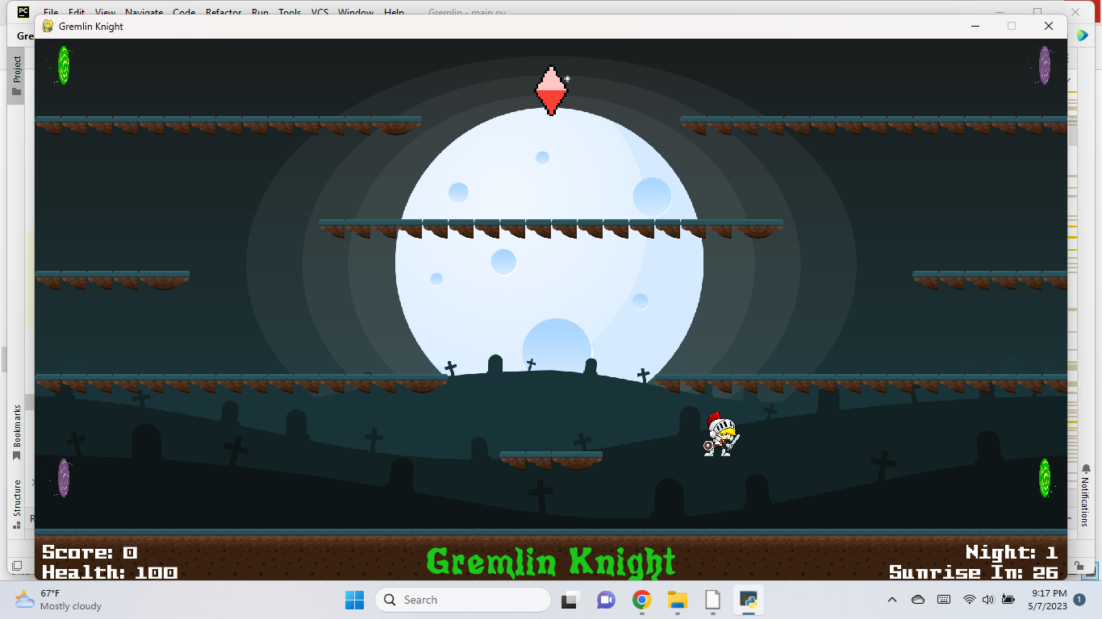
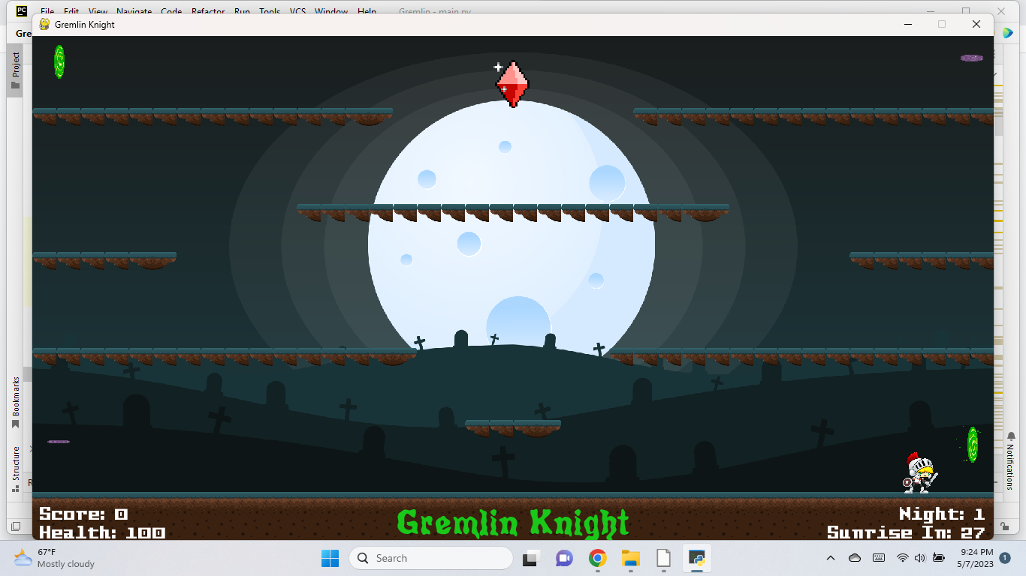
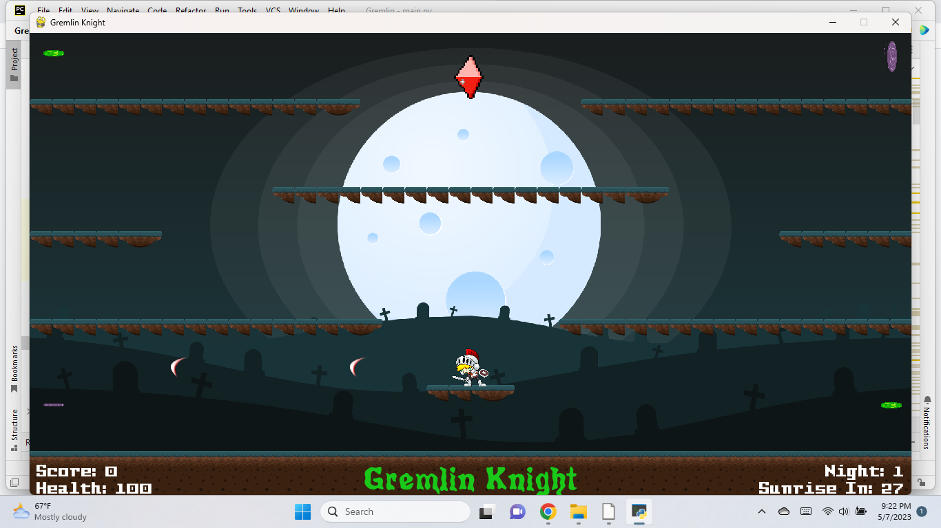
Animating the Hunter
Hunter jumps
Runs
Kills/attack
Transport through the screen
Move through the portals
Can change directions left and right
Can stay idle( breathing animation)

Slide 19
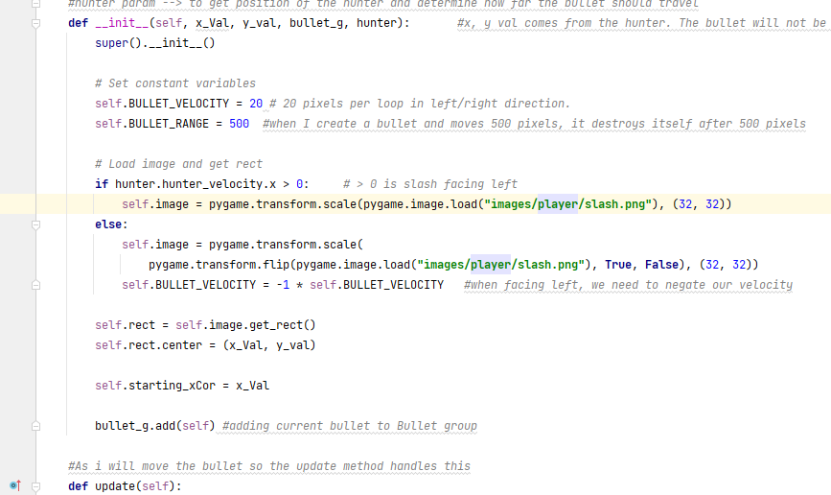
Collision checks
Sword slashes
Collision checks between hunter and platforms
collision between hunter and the portals
Slashes does not go on forever.
Kills after a certain range( 500 pixels )

Slide 20
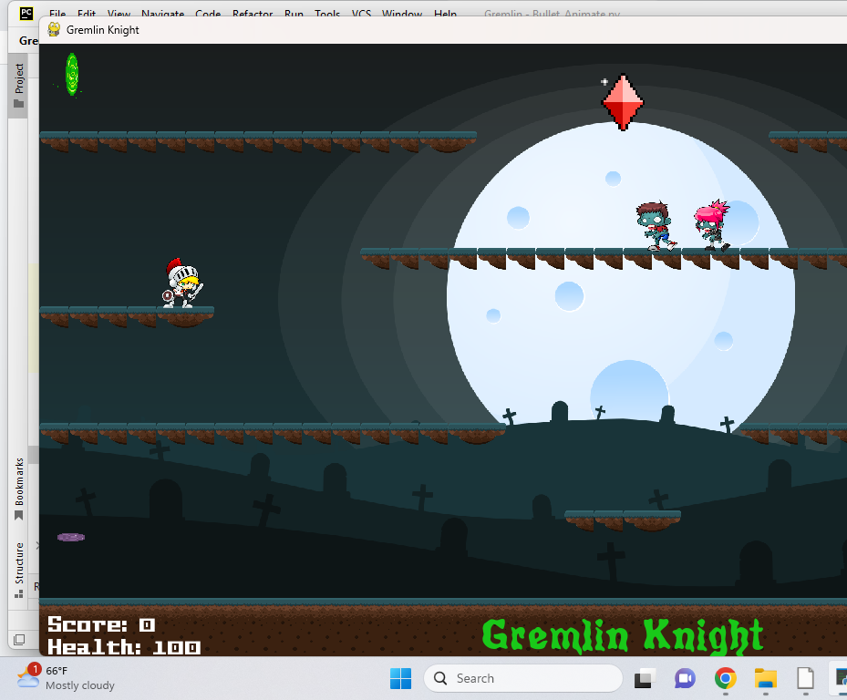
Animating the Gremlins
They walk
They die
They re-spawn after 2 secs if not collided with
They chase at a random speed
Their chasing speed goes up with higher game levels
They re-spawn faster as game level increase.
They transport through screens and portals
They have collision checks with the platforms

Slide 21
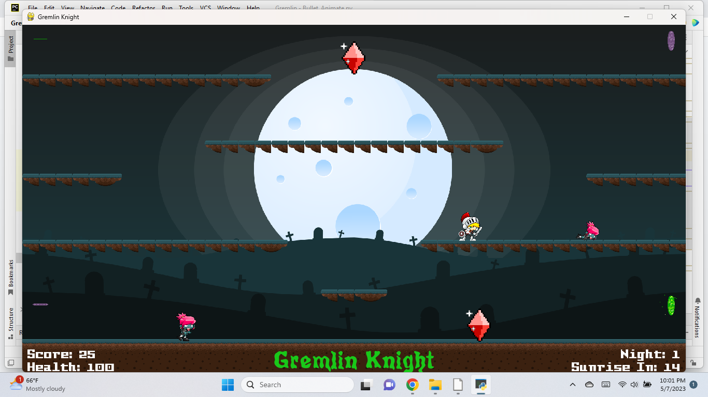
Game animations.
Hunter kills gremlins.
Hunter stomps on dead gremlin. Then a diamond is generated
Hunter collects diamond gets score bonus and health.
When a gremlin gets the diamond, a new gremlin adds up.
There is a cap on the health. Not >100

Slide 22
Animating the Gremlins
They walk
They die
They re-spawn after 2 secs if not collided with
They chase at a random speed
Their chasing speed goes up with higher game levels
They re-spawn faster as game level increase.
They transport through screens and portals

Slide 23
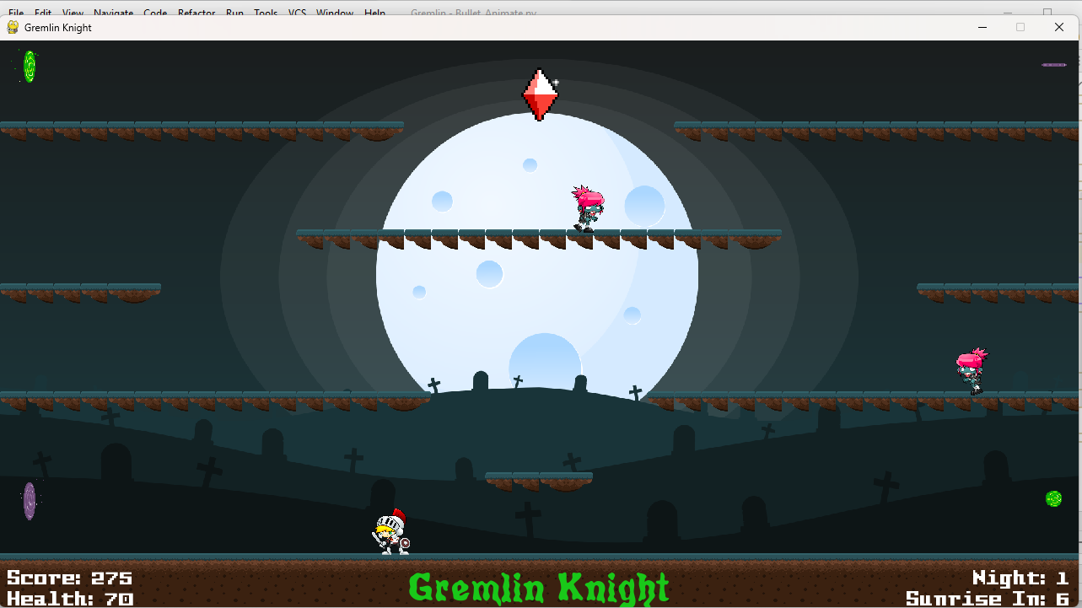
Updating score, health, night, time.
You have to survive the night for 30 secs
When stomp on a gremlin, score +25
When gremlin kills you, health (-20)
Collect a diamond- score (+100)
Collect a diamond- health(+10)

Slide 24
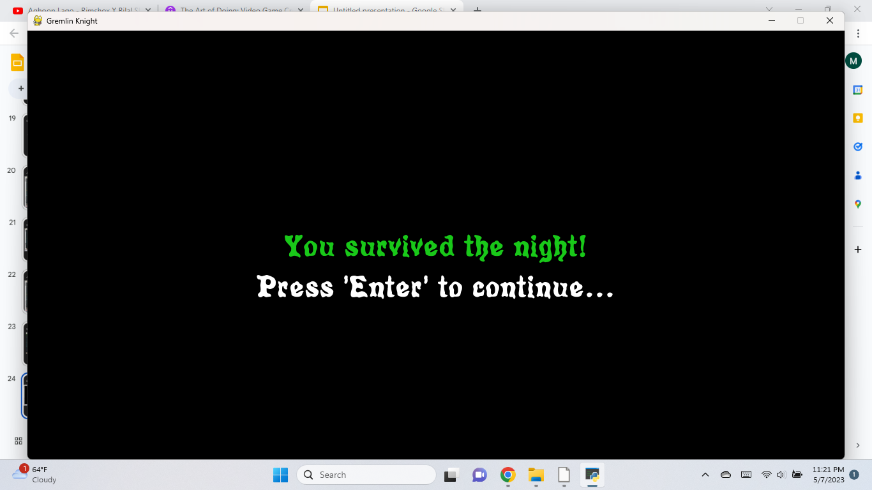
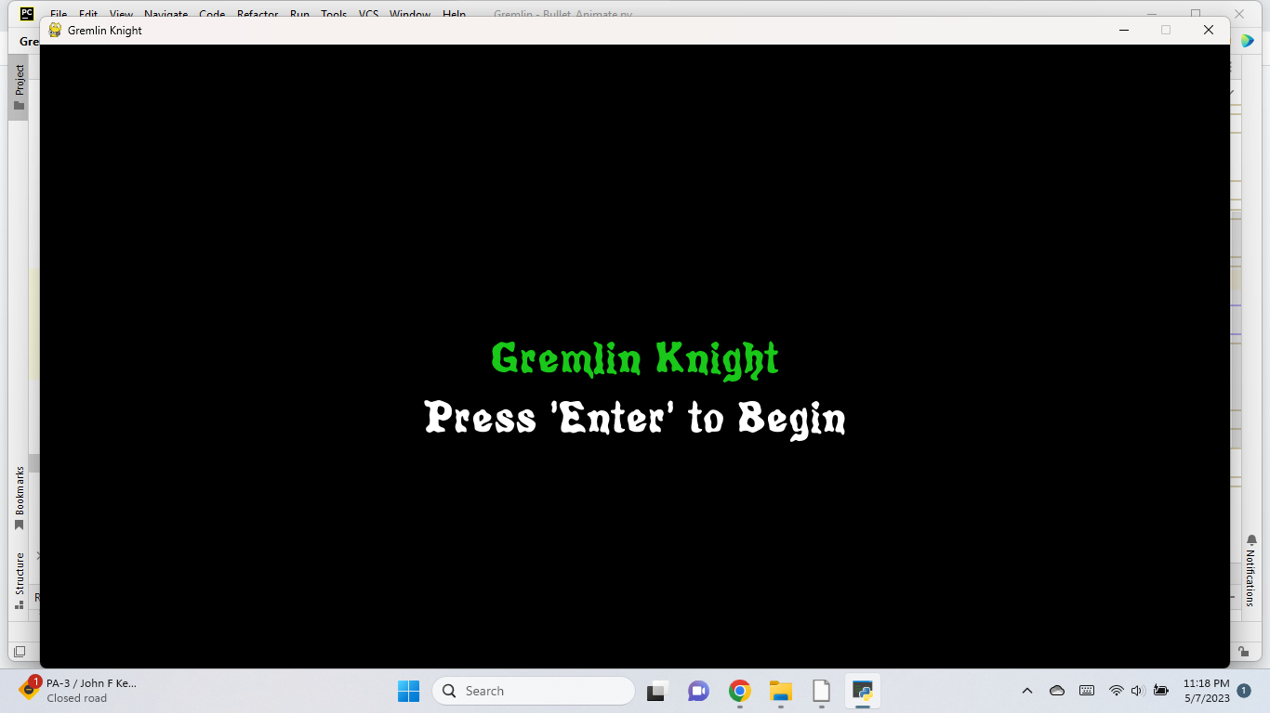
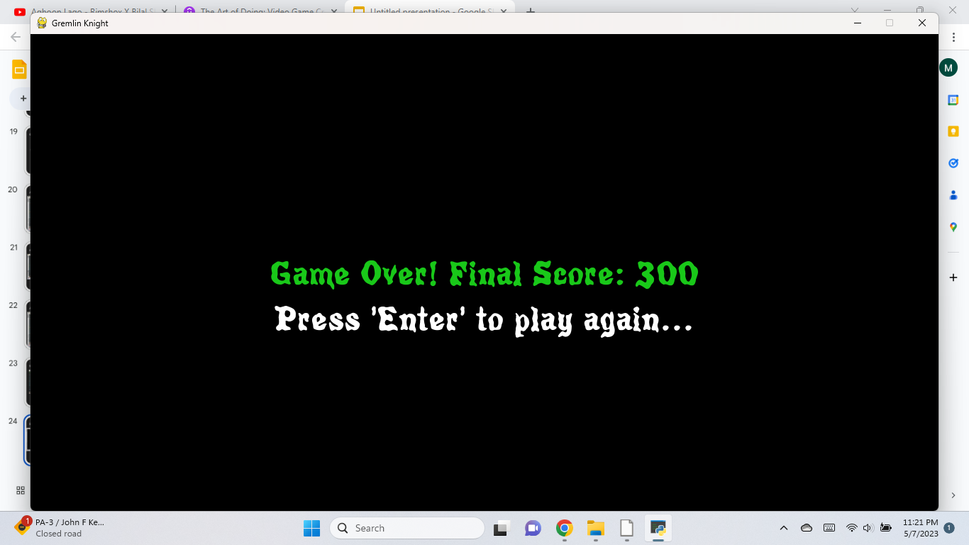
Last finish ups—
You have to survive the night for 30 secs

Slide 25
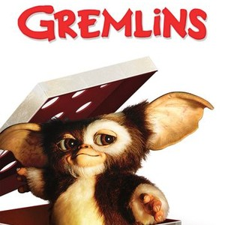
Thank you!

